Slide 1
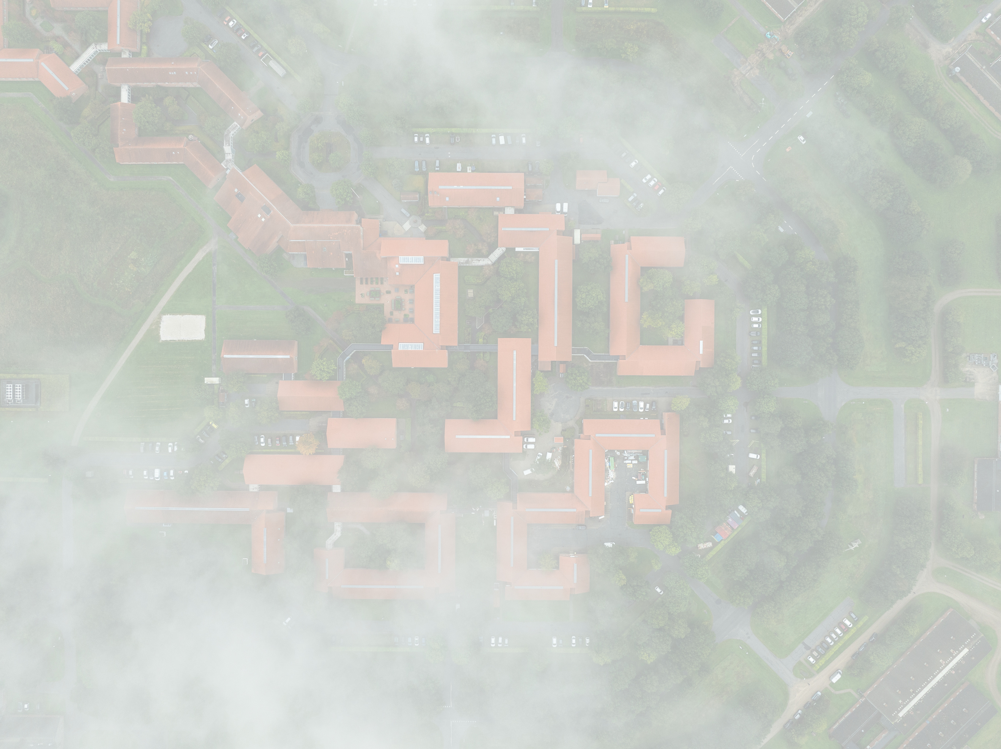

Ambition
We aim to be a leading international research environment for the green transition in agriculture, addressing global and local sustainability challenges driven by rising demands for food, energy, and biomaterials.
We create societal impact through research, innovation, education, policy support, and collaboration. Together, these efforts contribute to sustainable agricultural solutions that balance multiple objectives - while ensuring a healthy and supportive working environment.
About the Department

Slide 2
Agriculture with a low carbon footprint
Climate-resistant
cultivation systems
Key research areas
Agriculture with low pesticide consumption
Low nutrient emission agriculture
Preservation and improvement of soil quality
Sustainable digital
agriculture
Cultivation for
biodiversity
Plant-based foods

Slide 3
Head of Department
Plant Pathology and Microbiology
PLANMIK
Secretariat
STAB
Crop Health
CROP
Flakkebjerg
Research Platforms
Flakkebjerg
AU Viborg
Askov
Jyndevad
Crop Genetics and Biotechnology
CGB
Agricultural Biodiversity
ABD
Department structure
Center for Landscape Research in Sustainable Agricultural Futures
Land-CRAFT
Aarhus
Climate and Water
KLIMA
Agricultural Systems and Sustainability
SYSTEM
AU Viborg
AU Viborg
AU Aarhus
Soil Fertility
JORNÆR
Soil Physics and Hydropedology
JORD
Askov
AU Flakkebjerg
Jyndevad

Slide 4
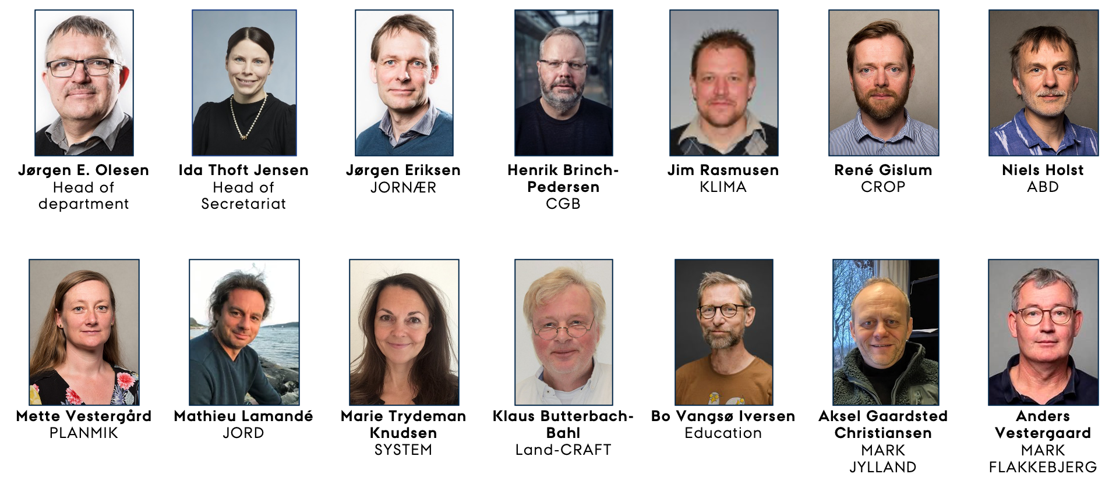
Department management

Slide 5
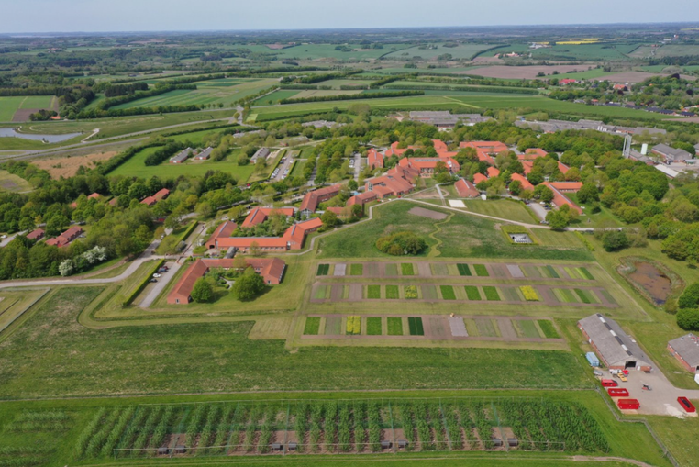
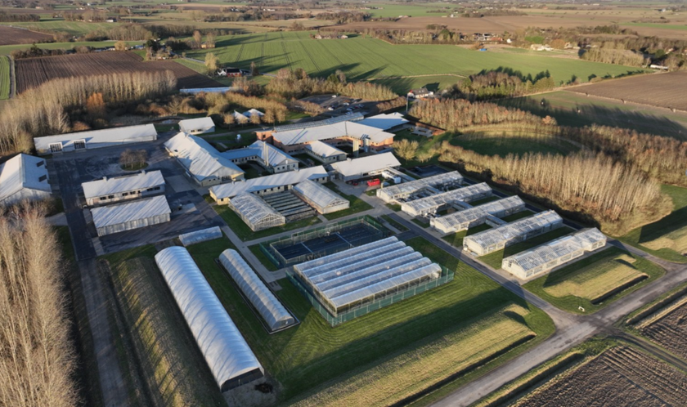
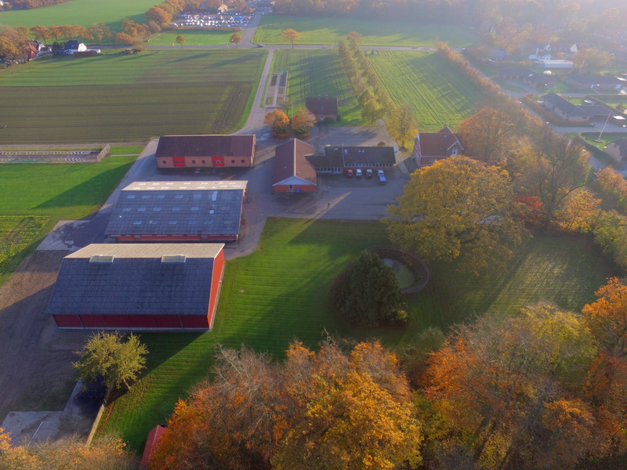
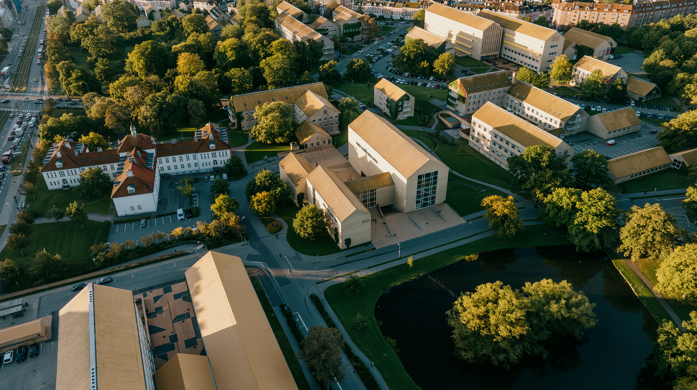
AU Viborg
AU Flakkebjerg
Locations
Experimental station Askov
AU Aarhus

Slide 6


Plant Pathology and Microbiology: PLANMIK
  The Global Rust Reference Center
  Microbiome aided plant resilience
  Nematodes
  Molecular characterisation and diagnosis of pests
ABD – Agricultural Biodiversity
  Ecological modelling lab
  Entomology
  Social-ecological systems simulation
  Animal, landscape and human simulation
  Honeybee diseases, genetics and pollination
AGRO Flakkebjerg
Crop Health: CROP
  Seed science and technology
  Herbology and application technique
  Pesticide resistance
  Disease and pest management
  Natural product chemistry and environmental
  chemistry
  Phytobiome studies
  Ecosystem services
  GMO
AGRO Flakkebjerg
AGRO Aarhus
Our
Sections
Land-CRAFT - Center for Landscape Research in Sustainable Agricultural Futures
  Landscape experimentation
  Digital landscape analyses
  Landscape modelling framework
  Socio-economy and stakeholder dialogue
AGRO Flakkebjerg
IN FLAKKEBJERG & AARHUS
Crop Genetics and Biotechnology: CGB
  Plant breeding
  New plant breeding techniques
  Genetics
  Biotechnology
  The quality of crops as feed, food and biomass
AGRO Aarhus
AGRO Flakkebjerg

Slide 7
KLIMA – Climate and Water
  Agrohydrology
  Bioenergy
  Climate change and biomass production
  Water quality
  Agrosystems modelling
  Informatics and GIS
  Agriculture’s climate impact
JORNÆR – Soil Fertility
  Biochar
  Grassland ecosystem services
  Microbial ecology of soil and manure
  Cover crops
  Emission of greenhouse gases
  Nutrients in wastes and fertilisers
Our
Sections
AGRO Foulum
AGRO Foulum
SYSTEM – Agricultural Systems and Sustainability
  Sustainable resource management
  Life cycle assessment of food and other bio-based
  products
  Organic animal production
  Organisation of food systems
  Productivity and profitability in farming
JORD – Soil Physics and Hydropedology
  Soil quality
  Soil spectroscopy
  Water and contaminant transport
  Digital soil mapping
  Soil mechanical behaviour
  Sustainable soil management
  Arctic soils
AT AU VIBORG
AGRO Foulum
AGRO Foulum

Slide 8
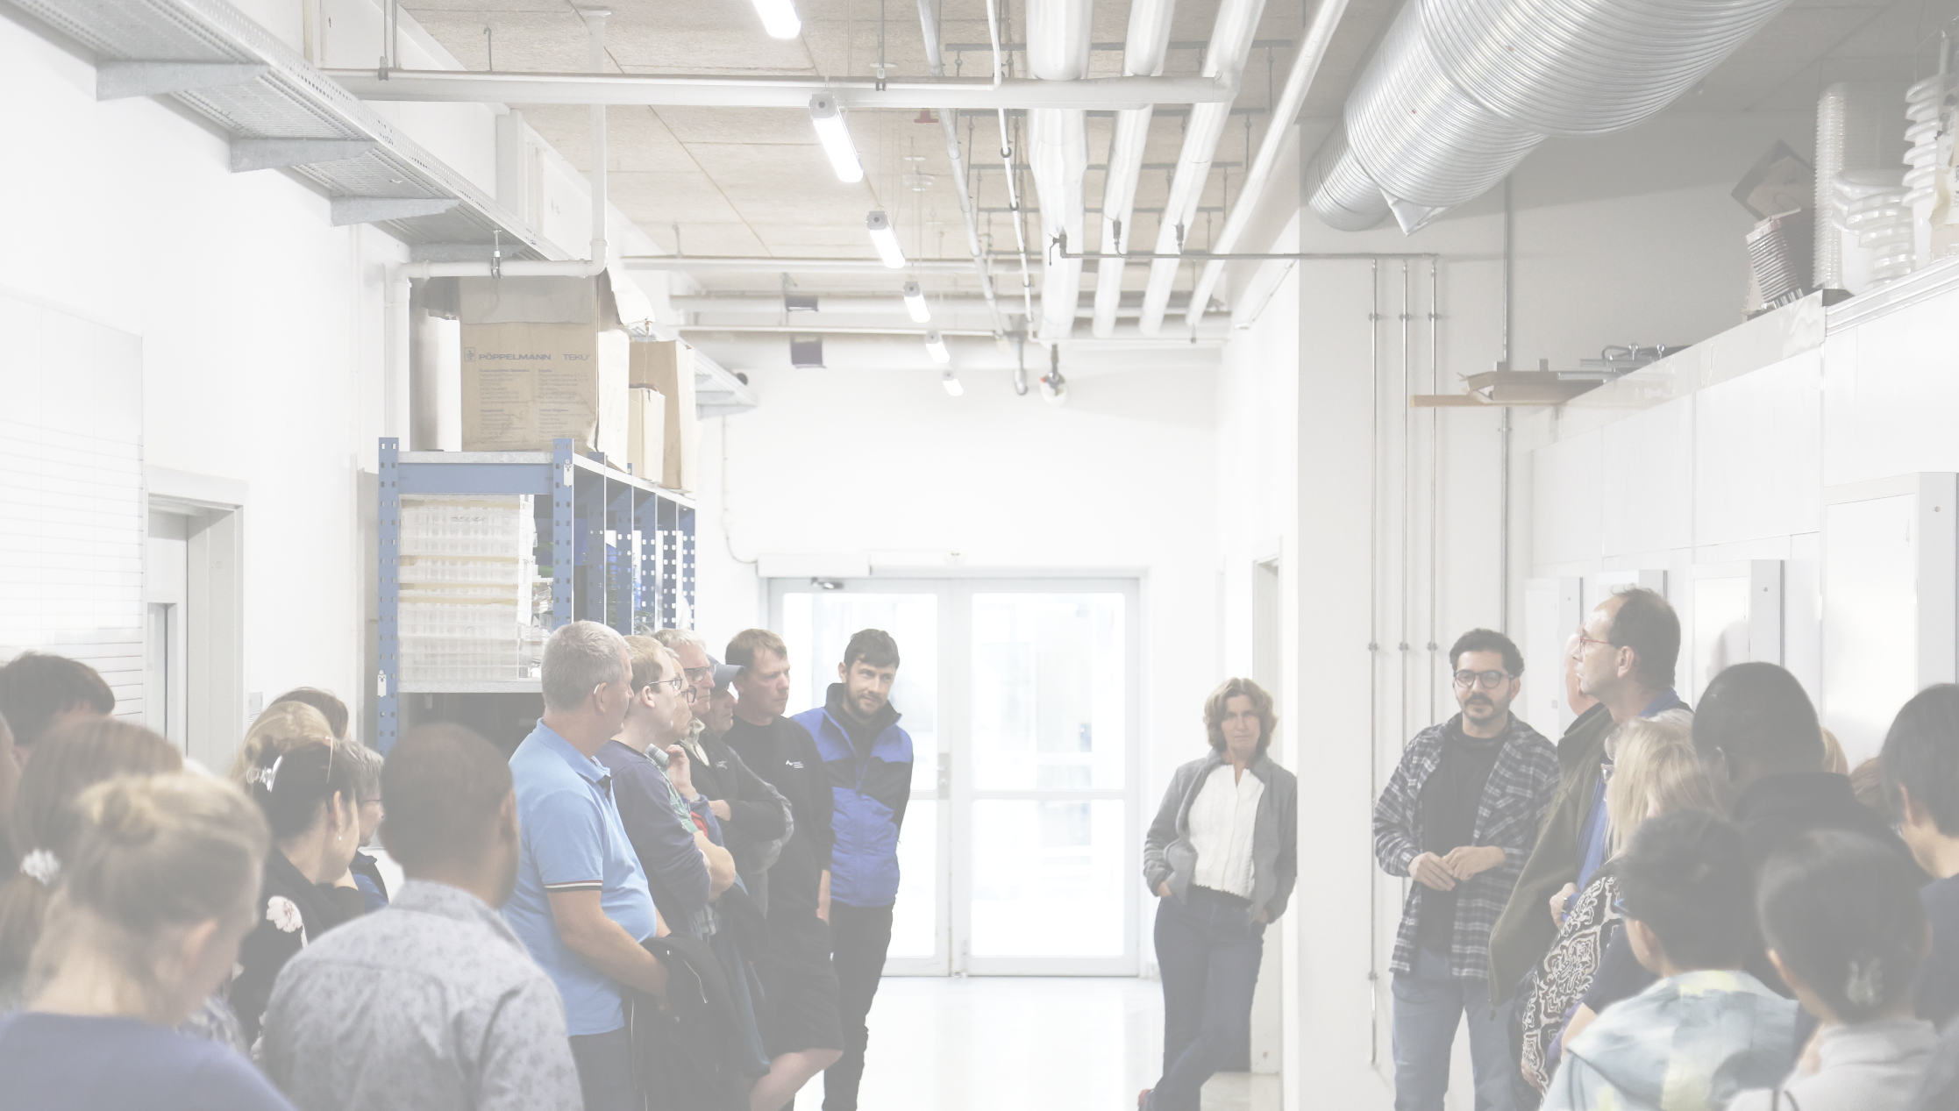

State-of-the-art
laboratories
World’s largest experimental biogas plant
Greenhouses, semifield facilities and lysimeter units
Access to onsite research farm animals
Research facilities
Climate chambers
~300 hectares of farmland for field trials
Climate stations
Global Rust Reference
Center
Solar panels
Biorefinery

Slide 9
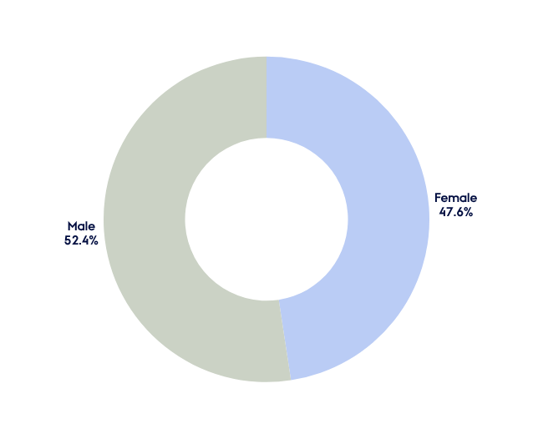
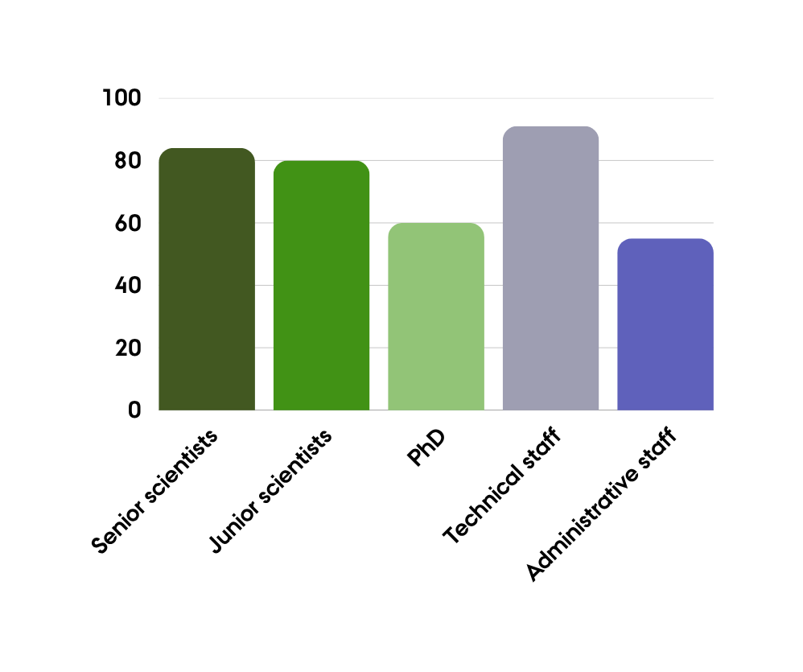
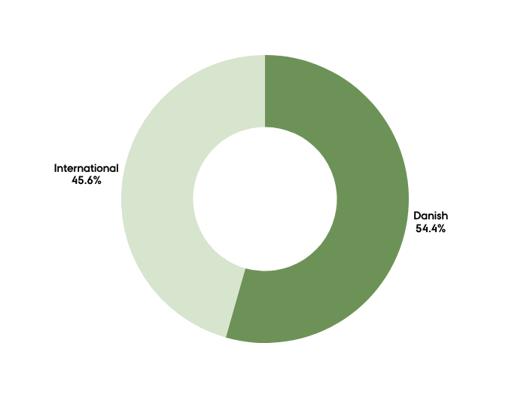
Staff

Slide 10
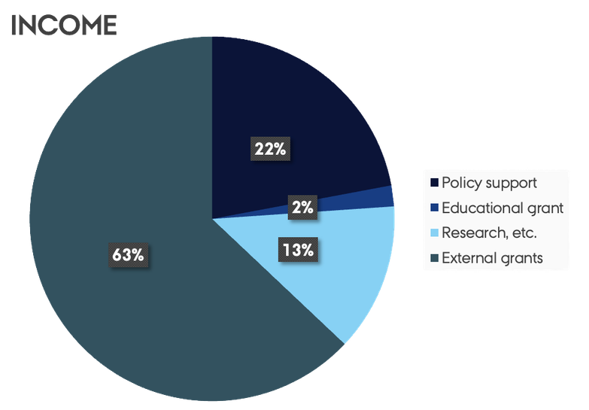
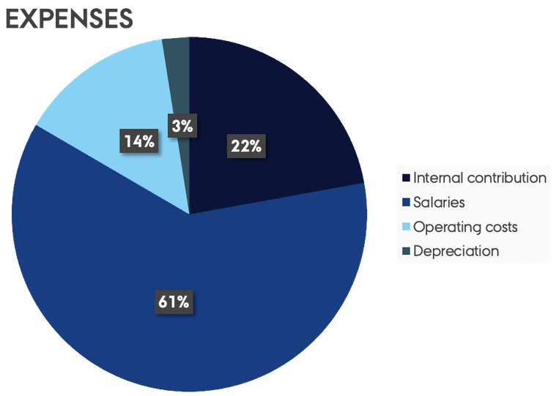
INCOME
Policy support
Educational grant
Research, etc.
External grants
Economy - 2025
EXPENSES
Internal contribution
Salaries
Operating costs
Depreciation

Slide 11

Ecological modelling lab
Entomology
ABD - Agricultural Biodiversity
Social-ecological systems simulation
Animal, landscape and human simulation
Honeybee diseases, genetics and pollination

Slide 12

Plant breeding
New plant breeding techniques
CGB – Crop Genetics and Biotechnology
Genetics
Biotechnology
The quality of crops as feed, food and biomass

Slide 13

Seed science and technology
Phytobiome studies
Herbology and application technique
CROP – Crop Health
Ecosystem services
Pesticide resistance
GMO
Disease and pest management
Natural product chemistry and environmental chemistry

Slide 14

The Global Rust Reference Center
PLANMIK – Plant Pathology and Microbiology
Microbiome aided plant resilience
Nematodes
Molecular characterisation and diagnosis of pests

Slide 15
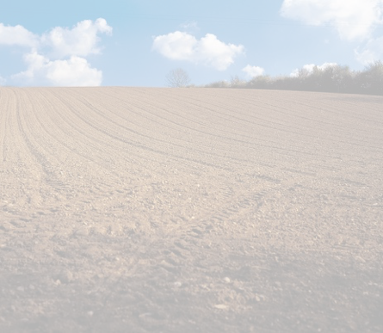
Soil quality
Soil mechanical behaviour
JORD – Soil Physics and Hydropedology
Soil spectroscopy
Sustainable soil management
Water and contaminant transport
Arctic soils
Digital soil mapping

Slide 16
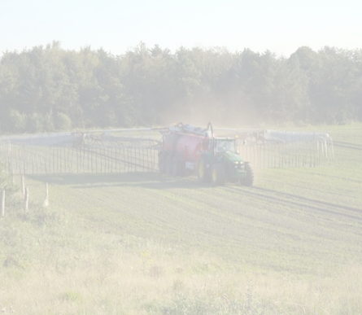
Cover crops
Microbial ecology of soil and manure
JORNÆR – Soil Fertility
Biochar
Emission of greenhouse gases
Grassland ecosystem services
Nutrients in wastes and fertilisers

Slide 17
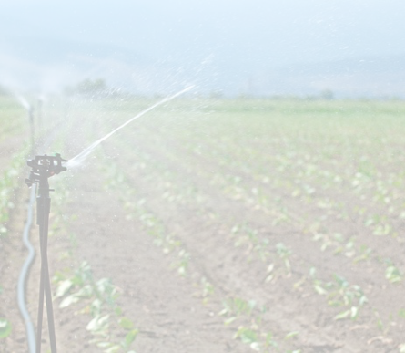
Agrohydrology
Agrosystems modelling
KLIMA – Climate and Water
Bioenergy
Informatics and GIS
Climate change and biomass production
Agriculture’s climate impact
Water quality

Slide 18
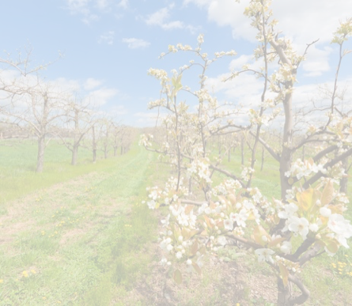
au
DEPARTMENT OF AGROECOLOGY
Sustainable resource management
Life cycle assessment of food and other bio-based products
SYSTEM – Agricultural Systems and Sustainability
Organic animal production
Organisation of food systems
Productivity and profitability in farming

Slide 19
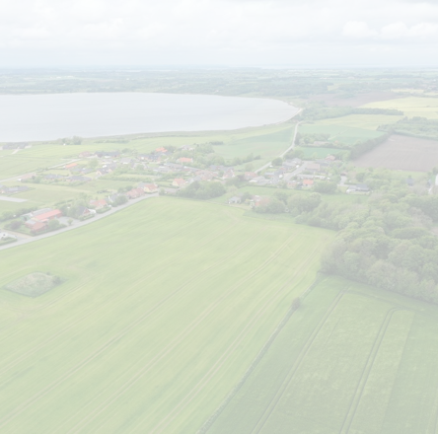
Landscape experimentation
Digital landscape analyses
LandCRAFT
Landscape modelling framework
Socio-economy and stakeholder dialogue

Slide 20
au
DEPARTMENT OF AGROECOLOGY

