Slide 1
AGRO Days 28-29 october 2024

Slide 2
AGRO DAYS - Purpose
In AGRO we aim to
Support collaboration among disciplines and among all staff groups
Ensure wellbeing and a good work-life balance among staff
Support students in their studies and younger staff in the career
Be a leading research institution in the agricultural green transition
AGRO Days supports this by
Improve knowledge on the department
Know your colleagues better
Understand how you can better collaborate within the department

Slide 3
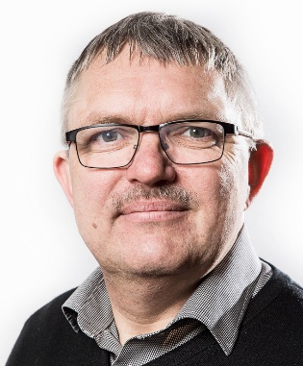
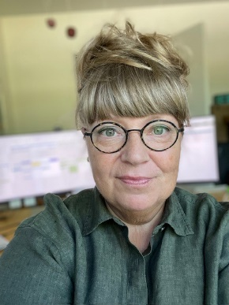
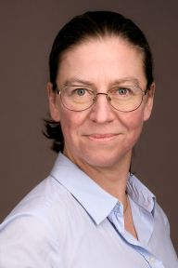
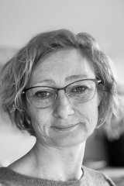
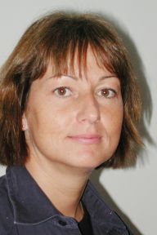
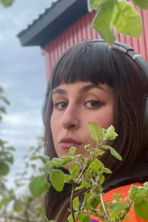
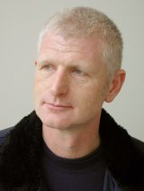
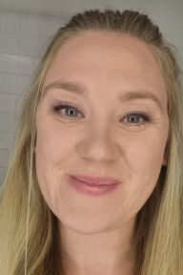
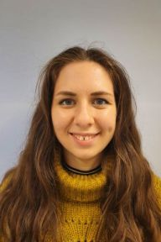
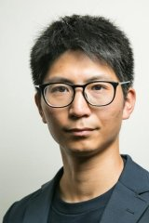
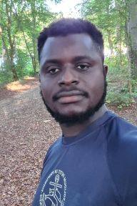
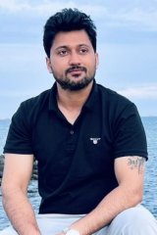
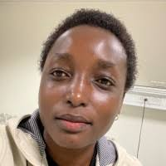
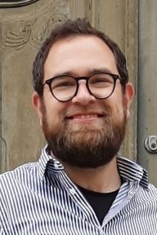
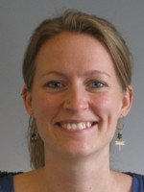
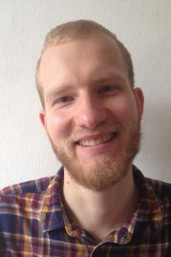
Organising committee
Jørgen E. Olesen Anna Dorthe Østergaard Isabella Leong Karina R. Christensen Ellen Jørgensen Camilla Kaskholt Hans H. Hansen Kathrine Høstgaard
Sara Miller Takashi Tanaka Enoch Kudjordjie Ameesh Khatkar Winnie Ntinyari Johannes Pullens Mette Odgaard Moritz Gehlmann Bodil Hjarvad Margit Paulsen

Slide 4
Monday 28 october 2024
DAY 1 |  | Responsible
10:00 – 10:30 | Coffee & rundstykker | All
10:30 – 11:00 | Welcome & state of affairs | Jørgen E. Olesen
11:00 – 12:30 | Get to know your colleagues and your carbon footprint | Bodil / Karina Andreas Stounbjerg
12:30 – 13:30 | Lunch | All
13:30 – 15:00 | Success stories from the sections | JEO All sections
15:00 – 16:00 | Action plans from the AGRO Strategy | Bodil Committee members
16:00 – 16:30 | Coffee | All
16:30 – 18:00 | Collaboration within the department | JEO / Margit / NN
18:00 – 19:30 | Check in at hotel | All
19:30 – 20:30 | Dinner | All
20:30 – 21:00 | Quiz | Winnie / Ameesh / Sara

Slide 5
tuesday 29 october 2023
DAY 2 |  | Responsible
08:30 – 10:00 | AI – Artificial Intelligence – what does if mean for us | Isabella / Jens G./Diba
10:00 – 10:30 | Coffee break
10:30 – 12:45 | PARALLEL SESSIONS
 | Scientists: New research staff in the department Collaborative activities within AGRO themes Data management (FAIR) | Jeroen / JEO
 | Technicians: Standard procedures in the field Use of drones, robots, and GPS solutions in field trials | Hans
 | Lab technicians: Chemical risk assessment Organisation of the lab groups | Anne-Pia Larsen/ Louise Rasmussen/ Karin Dyrberg
 | Secretariate: Organisation in the secretariate | Karina / Bodil / Ida
12:45 – 13:00 | Wrap up and goodbye – with a lunch bag to-go! | Jørgen E. Olesen

Slide 6
Topics
Department organisation
Department economy and funding
Department strategy
Educational programs
Research integrity
GDD and SDD
International evaluation

Slide 7
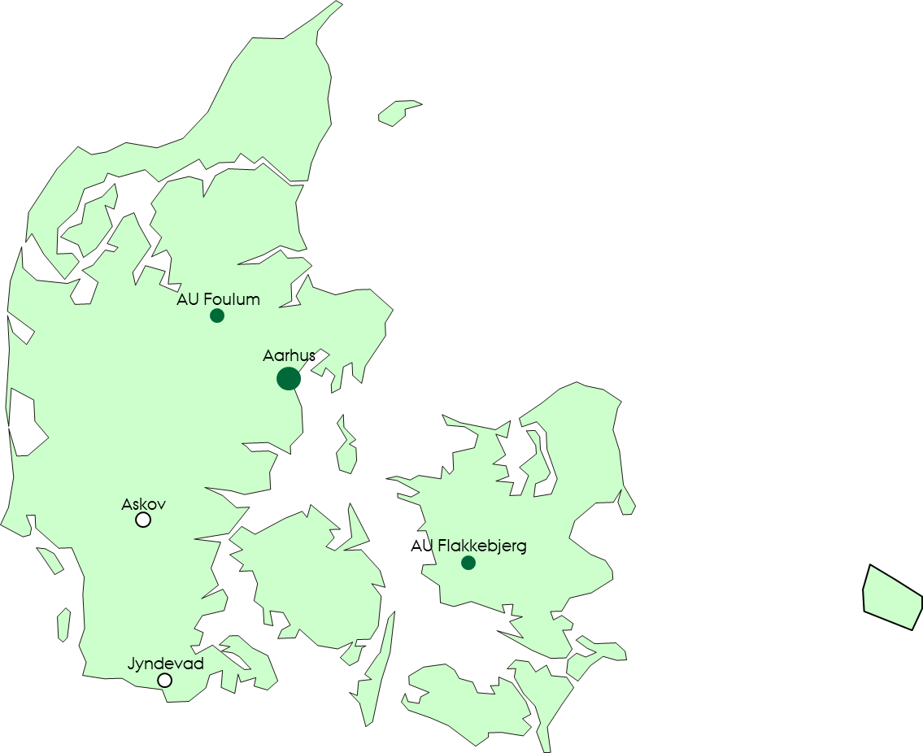
Department of Agroecology - organisation
Head of Department
Research sections
Plant Pathology and Microbiology PLANMIK
Secretariat STAB
Flakkebjerg
Crop Health CROP
Crop Genetics and Biotechnology CGB
Research stations - MARK
Flakkebjerg Foulum Askov
Agricultural Biodiversity ABD
Aarhus
Center for Landscape Research in Sustainable Agricultural Futures Land-CRAFT
Climate and Water KLIMA
Agricultural Systems and Sustainability SYSTEM
Foulum
Soil Fertility
JORNÆR
Soil Physics and Hydropedology
JORD

Slide 8
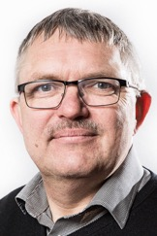
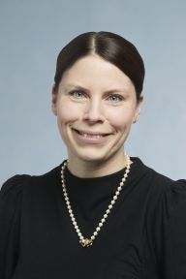
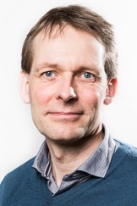
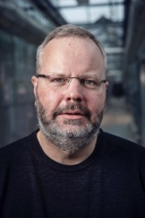
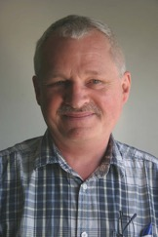
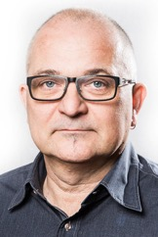
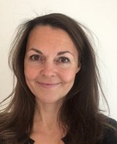
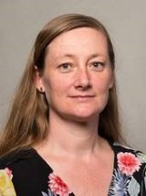
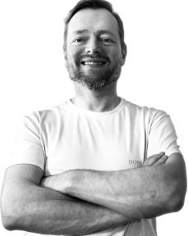
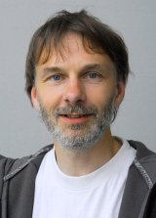
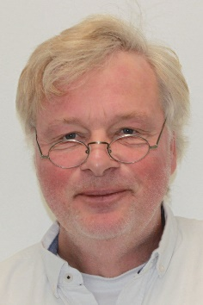
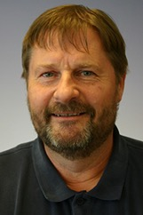
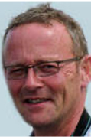
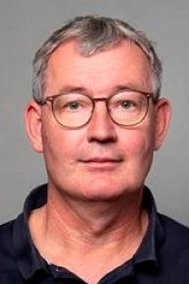
Department management
Jørgen Eriksen
JORNÆR
Deputy head of dept.
Henrik Brinch-Pedersen
CGB
Deputy head of dept.
Jørgen E. Olesen
Head of department
Ida Thoft Jensen
Head of Secretariat
Henrik Brinch-Pedersen
CGB
Mathias N. Andersen
KLIMA
Mogens H. Greve
JORD
Marie T. Knudsen
SYSTEM
Mette V. Madsen
PLANMIK
René Gislum
CROP
Niels Holst
ABD
Klaus Butterbach-Bahl
Land-CRAFT
Jens B. Kjeldsen
FOULUMGÅRD
Henning C. Thomsen
ASKOV
Anders Vestergaard
FLAKKEBJERG

Slide 9
Committees in AGRO
Department management
Policy support committee
Research committee
Agro department forum
Liaison committee
Occupational health and safety committee
Diversity and equality committee
PhD programme committee
Degree programme committee
Teaching committee
Business and innovation committee
Laboratory committees (Foulum, Flakkebjerg)
Committee on field equipment
Data Management Committee
Building committees (Foulum, Flakkebjerg, Aarhus)
Department management

Slide 10
Topics
Department organisation
Department economy and funding
Department strategy
Educational programs
Research integrity
GDD and SDD
International evaluation

Slide 11
Department economy and staffing
SESS group from EcoScience not included

Slide 12
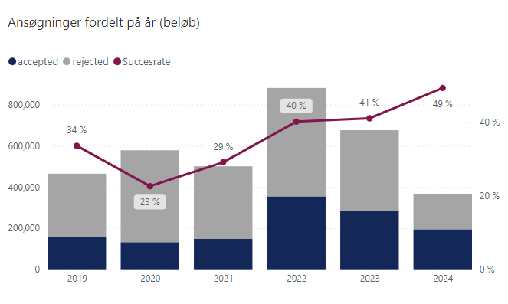
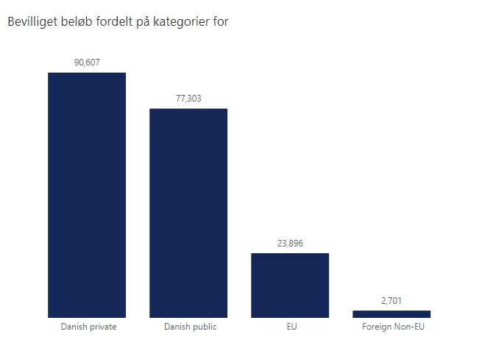
external funding (REAP)

Slide 13
Economy - considerations
Strong attraction of external funding (transfer funds to the future)
Increased rent (more office and lab space and space for students)
Recent staff growth of 15% per year, but projected only 5% in 2025
Increase support functions (management, data, communication)
Increase student recruitment for viable educational programs
Continue developing and modernizing research facilities
Efficient recruitment processes – ensure / improve transparency
We recruit very qualified staff – this is also being noticed outside

Slide 14
Housing and land
Housing
AU-Viborg: Continued development of educational spaces
AU-Viborg: Offices in PV32 will be available from January 2025
AU-Viborg: More office space at Foulumgaard
AU-Aarhus: Top-floor in 1171 available from summer 2025
AU-Flakkebjerg: Renovations and better use of existing space
AU-Flakkebjerg: Living facilities in recently bought property
Land
AU-Viborg: Rented more land
AU-Flakkebjerg: Bought property (through AUFF)
Jyndevad: New building for storage and other facilities (spring 2025)

Slide 15
Topics
Department organisation
Department economy and funding
Department strategy
Educational programs
Research integrity
GDD and SDD
International evaluation

Slide 16

Agro strategy
Ambition: We continuously work to strenqthen our position as an internationally hiqhly recoqnised research environment for the aqricultural qreen transition solvinq current and future qlobal and local sustainability challenqes driven by the qrowinq demand for foods, enerqy, and biomaterials.
Throuqh research, innovation, policy support, educational proqrammes, talent development, business collaboration and communication to society, we will contribute to sustainability paradiqms within aqriculture that meets multiple sustainability objectives.
We will enable a thriving workinq environment for the benefit of staff well-beinq and work quality.

Slide 17
Agro strategy
10 action areas:
Research
Policy support
Educations
Business collaboration
Data management
Communication
Talent development
Career and competence development
Working environment
Diversity and gender equality
Action plans have been developed and being implemented

Slide 18
Agro strategy
8 focus areas:
Low carbon footprint farming
Climate resilient cropping systems
Low pesticide-input farming
Low nutrient emission farming
Maintaining and improving soil quality
Sustainable digital-based farming
Farming for biodiversity
Plant-based food
Activities ongoing to ensure collaboration within focus areas

Slide 19
Topics
Department organisation
Department economy and funding
Department strategy
Educational programs
Research integrity
GDD and SDD
International evaluation

Slide 20

Our educational programs
Agrobiology (BSc and MSc) at Aarhus
Continues but is being phased out
Plant and food science (BSc) at AU Viborg
Too few students applied for this in 2024
Recruitment efforts are being strengthened (all to contribute)
Application for converting to in international BSc submitted
Plant and Soil Science (MSc) at AU Viborg
Starts at in 2027 (in preparation)
This is a must win

Slide 21
Topics
Department organisation
Department economy and funding
Department strategy
Educational programs
Research integrity
GDD and SDD
International evaluation

Slide 22
Research integrity
Our mandate as a university is based on trust!!!
Therefore, research integrity is paramount and is core to all we do
Research integritry incompasses:
Planning
Execution,
Data management
Publication
Dissemination
Detailed guidelines on the AU website (make yourself familiar)

Slide 23
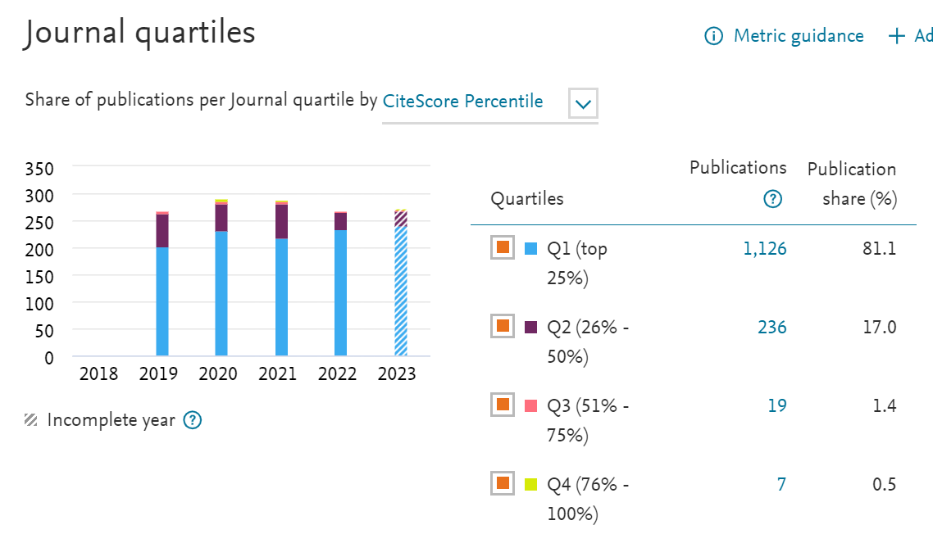
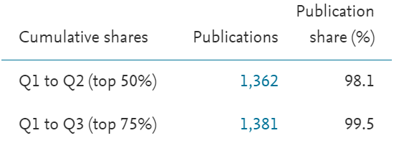
Publish in good journals (Q1 + Q2)
Avoid predatory journals

Slide 24
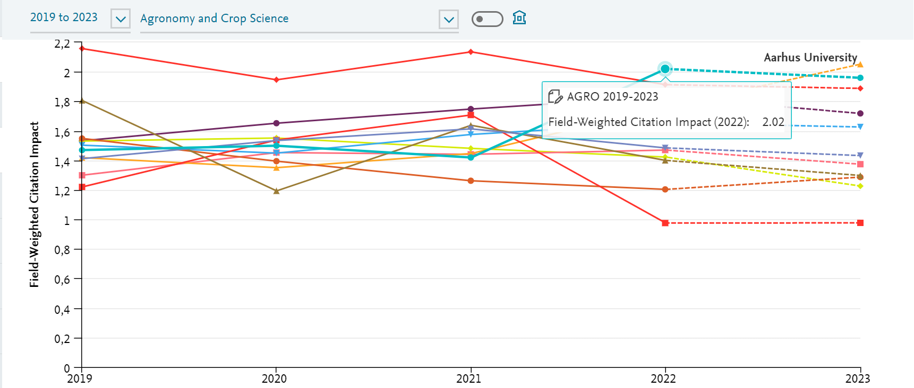
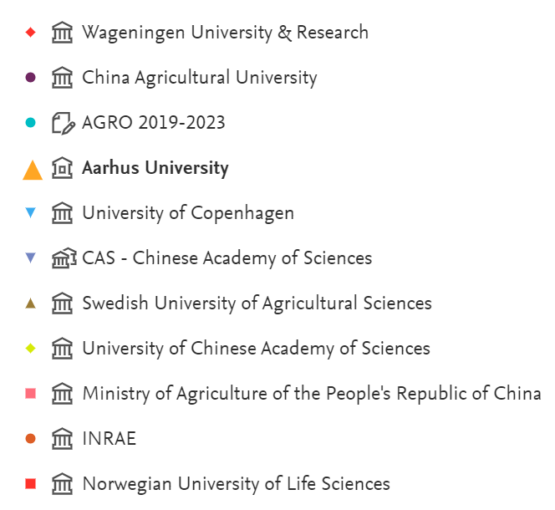
We are among the best cited

Slide 25
Topics
Department organisation
Department economy and funding
Department strategy
Educational programs
Research integrity
GDD and SDD
International evaluation

Slide 26
Staff development dialogue (SDD/MUS)
Topics
Well-being and motivation
Working environment
Career and competence development (separate for staff groups)
Summary (agreements)
Other dialogues
Teaching portfolio (for those with teaching obligations)
Senior dialogue (for staff above 60 years)

Slide 27
Group development dialogues (GRUS)
Topics
Well-being and cohesion
Innovation and department development
Succession management
Research based policy advice
Teaching and supervision
GRUS can be conducted for whole sections or in smaller groups

Slide 28
Topics
Department organisation
Department economy and funding
Department strategy
Educational programs
Research integrity
GDD and SDD
International evaluation

Slide 29
International evaluation 2025
What: We evaluate and take stock of the collective effort in the department with the intention of establishing a forward-looking perspective
Why: To take stock of current research activities and assess the viability of research priorities
How: We write a self-evaluation report (20-30 pages) on department level focusing on our research and science-based policy advising
When:
Self-evaluation (Apr-Jul 2025)
External panel visit (Oct 2025)
Concluding meeting (Dec 25)

